Slide 1
Lab Equipment Sourcing
An application for staff and students to view lab equipment details (such as location), the availability of the equipment, and a booking system to manage it all.
http://54.206.103.30/
Notes:
Welcome our Lab Equipment Sourcing presentation This is a Web Application developed for the CQU Engineering department, feel free open up the app in your browser and follow along during the demonstration using the IP address seen throughout the presentation

Slide 2
Business Value and App goals
Logging of resources in a digital space allows for data analysis and capacity planning.
Accessibility
Efficient processes
Effective results
Reduce unessential actions
Reduce human resources required
Productivity
http://54.206.103.30/
Notes:
The Logging of resources in a digital space provides the infrastructure for data analysis and capacity planning giving lab technicians and other staff members more control and understanding of the equipment and frequency at which it is used at CQU. Accessibility is a primary goal to provide ease of access to both students and staff members when locating and using lab equipment with efficient processes in searching, locating and booking equipment leading to more effective results for both the usage and management of equipment. The increased accessibility and efficiency are contributed to the reduction of unessential interactions required to perform simple tasks within the lab leading to a reduction in human resources and effort required. There are other intangible benefits of increased productivity for all lab users by minimising downtime and interuptions.

Slide 3




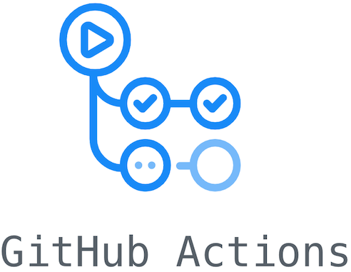
Application Technology Stack
CakePHP 4
PostgreSQL database
Hosted on AWS LightSail
Docker
CI/CD - GitHub Actions
http://54.206.103.30/
Notes:
Leaving this for Jack to write, since he implemented 3 out of 4 of these features

Slide 4
Use cases and demonstration
Authorisation/Authentication
Login
Lab Equipment
Search/Filter
View
Book
http://54.206.103.30/
Notes:
The main

Slide 5
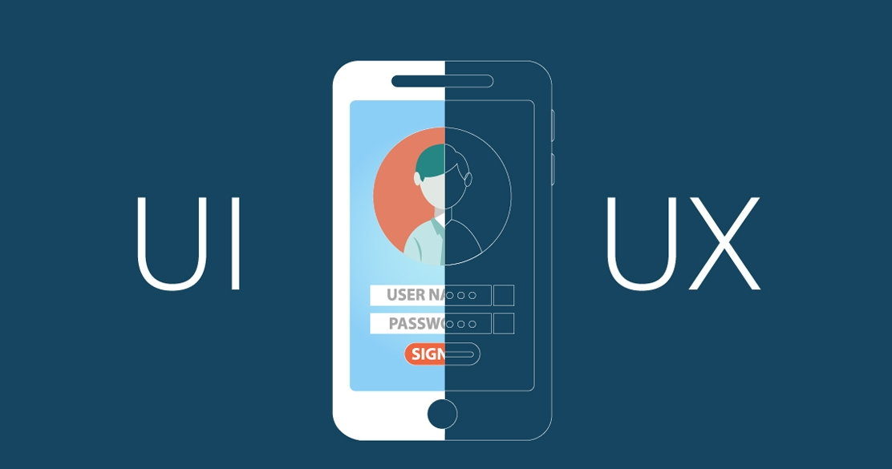

User Centred Design
UI is mobile responsive, and accessibility has been considered
Persona Based Acceptance Testing
Student and Staff Personas
Age, language, tech literacy, device/os
Personas with accessibility requirements
http://54.206.103.30/
Notes:
Source: https://reviewmyams.com/blog/developing-user-personas-enhance-your-content-marketing source: https://www.quora.com/What-are-the-steps-to-be-a-UX-UI-designer The app focuses on a balance between UI and UX to provide the most intuitive layout and use flow so that users may instinctively navigate throughout the app without needing specific instructions or feeling confused. This includes an easy to read and follow UI system that is mobile responsive with high flexibility between browsers and devices. UI and UX designs were detailed and refined through a persona based user acceptance testing process that consisted of both staff and student personas' with different levels of use requirements, age, technology literacy, operating system and device preferences, native language, special accessibility requirements and more.

Slide 6


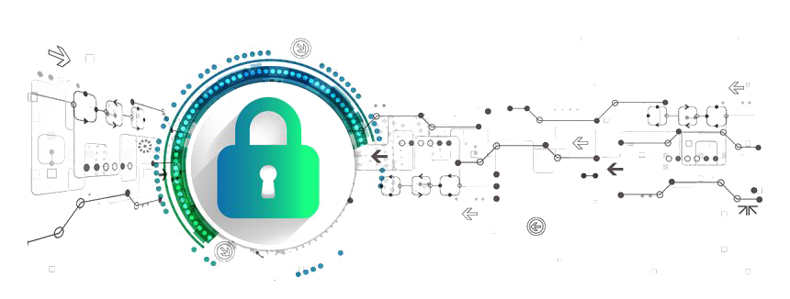
Future Goals
OAuth 2 or CQU authentication system
Integration to CQU systems including private repository and private CI/CD (GitLab)
Additional security measures including HTTPS
http://54.206.103.30/
Notes:
Source: https://www.pngall.com/cybersecurity-png/download/40665 Source: https://pngtree.com/element/down?id=NTA0NzMzOQ==&type=1&time=1632534162&token=Nzc4OWZhMmUwZDMzZWI0MDZiNGI3MmUzYmU4YjI4ZTA=

